Slide 1
Features of MS PowerPoint in ICT
How PowerPoint helps communication & learning
Name: Wajiha Nazir
Course: Information and communication Technology
Date: 1/10/2025
Notes:
Quick greeting and one-line context:
"Today I’ll show how PowerPoint’s features support ICT teaching and communication."

Slide 2
Agenda
Introduction to ICT & presentation context
Core PowerPoint features
SmartArt demo (process)
Animations & transitions
Multimedia & accessibility
Conclusion + Q/A

Slide 3

Introduction to ICT
ICT stands for Information and Communication Technology. It includes the tools, systems, and devices that allow people to create, store, and share information.
Education: ICT makes learning more interactive by using tools like presentations, e-learning platforms, and simulations.
Business: Companies use ICT to improve communication (emails, video conferencing), manage data, and automate processes.
Daily Life: From smartphones to social media, ICT connects people worldwide and makes access to information easier.

Slide 4
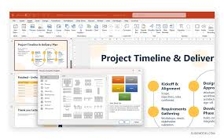
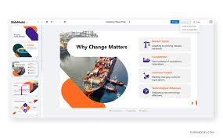
What is MS PowerPoint?
Slide-based presentation software for communication & teaching.
Supports themes, multimedia, interactivity, and exports.

Slide 5
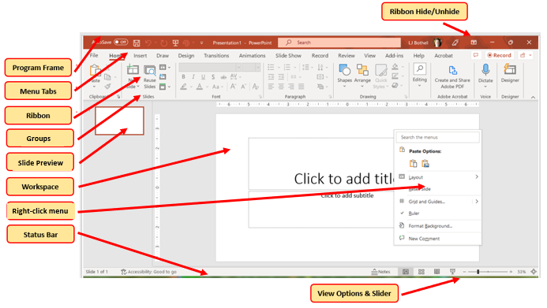
Key features
Left column: Slide Master, Themes & Templates, Layouts, Slide Sorter
Right column: SmartArt & Charts, Transitions & Animations, Multimedia, Presenter View
Speaker notes: One sentence on why each matters.
Design action: Use icons (Insert > Icons) above each short label.

Slide 6
SmartArt demo: Presentation Process
President
VP-Sales
VP Marketing
VP-Accounting
Underling 1
Underling 2
Minion 1
Minion 2
Assistant 1
Assistant 2
Assistant 3
What to put: SmartArt showing Planning → Designing → Animating → Presenting
PowerPoint steps: Insert > SmartArt > Process > Basic Process. Add text. Animate one by one.

Slide 7
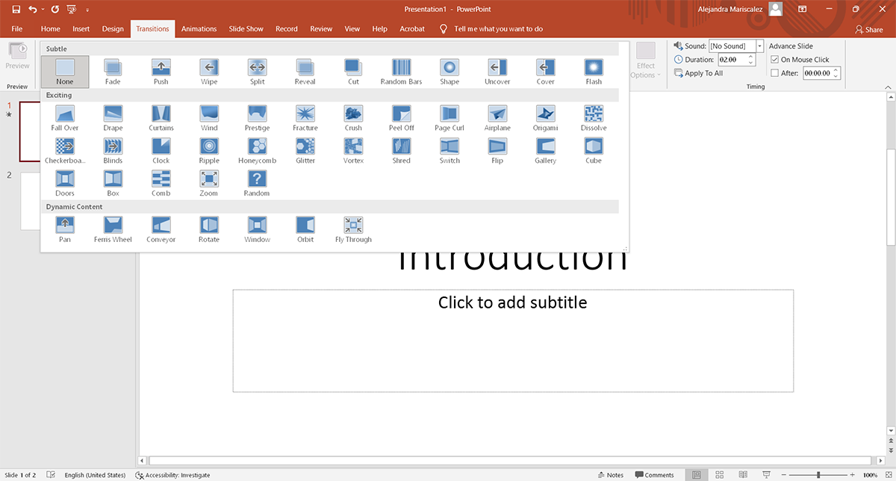
Animations & Transitions
Animations make presentations dynamic and emphasize important points.
Transitions create smooth changes between slides.
Examples: Fade for simple entry, Grow/Shrink to highlight, Fly Out for exit effects.
Transitions like Fade, Push, and Morph improve flow and keep audience engaged.

Slide 8
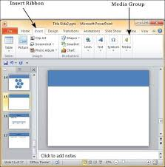
Multimedia
Multimedia improves engagement by combining visuals, sound, and motion.
PowerPoint supports videos, audio narrations, and even screen recordings.
Example uses: showing a tutorial video, embedding a company introduction, or adding background narration.
Steps: Insert > Video or Insert > Audio > Record. Compress media to save space.

Slide 9
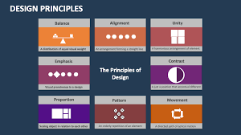
Design principles
Fonts: Use simple, professional fonts like Calibri or Arial. Title text 36–44pt, body text 20–28pt.
Contrast: Dark text on light background or vice versa for readability.
Text rules: Use the 6×6 rule (≤ 6 lines per slide, ≤ 6 words per line).
Visuals: Support points with icons, charts, or images.
White space: Don’t overcrowd slides; leave space for clarity.

Slide 10


Slide 11
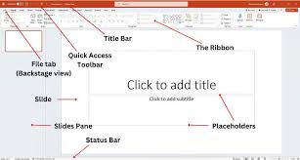
Conclusion
PowerPoint improves clarity.
Supports multimedia and visuals.
Enables interactivity.
Encourages effective ICT-based communication.

